Slide 1
Profiling cell-specific transcriptomes in the brain: An RNA-seq case study
Miranda M. Darby, Ph.D.
BIFX 504
10/26/21

Slide 2
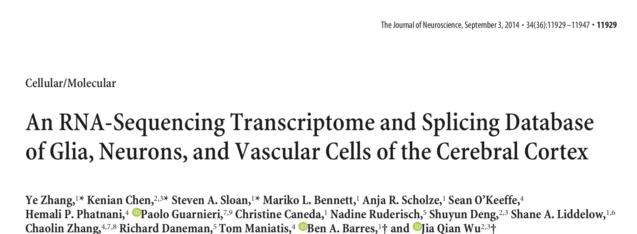
All cells have the same DNA, but transcriptomes are cell-specific.
Annotated transcript (splicing) isoforms are based on most commonly studied cells, so the transcriptomes of brain cells are not well studied.
Single-cell studies only detect most common genes, so another strategy is needed

Slide 3
Goal 1: Figure out the full transcriptomes of individual cell types in the brain.
Step 1: Collect samples of individual cell types
Step 2: Sequence them
Step 3: Put sequencing reads in context of genome and transcripts
Step 4: Quantify transcripts
Goal 2: Compare transcriptomes to each other to see what can be learned.
Step 5: Differential Expression Analysis
Step 6: Gene Set Enrichment Analysis

Slide 4
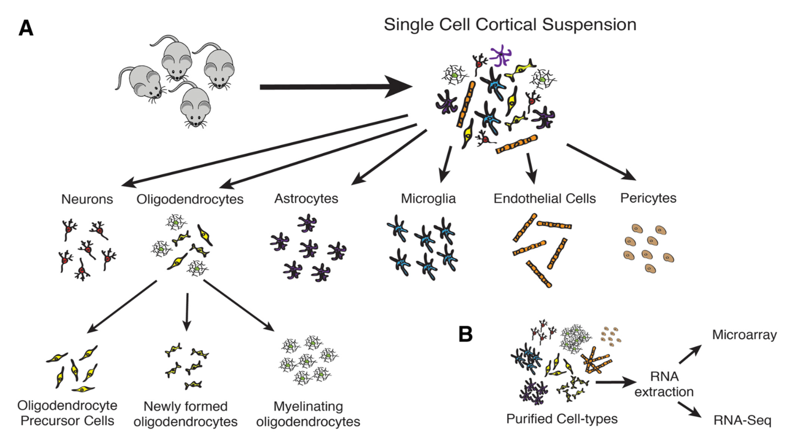
Step 1: Collect samples of individual cell types.
J. Neurosci., September 3, 2014 • 34(36):11929 –11947

Slide 5
Step 2: Sequence them.
Collect RNA
Check quality
Prepare sequencing libraries
Check quality
Sequence them
Check quality

Slide 6
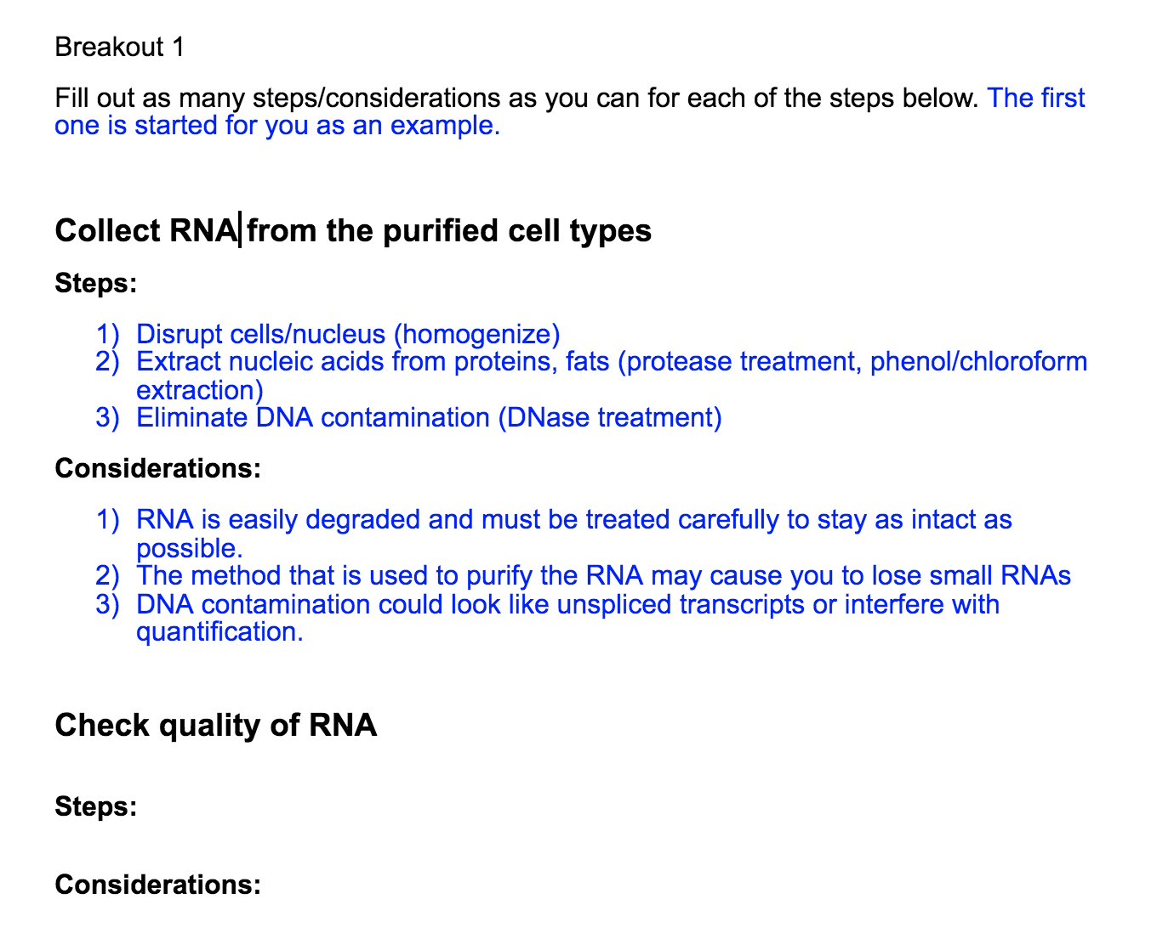
Step 2: Sequence them.
Collect RNA
Check quality
Prepare sequencing libraries
Check quality
Sequence them
Check quality
Breakout link:
https://docs.google.com/document/d/1GpEhvTSO126oFkWeNsRgVMwVlfxzrRN8R3EYU0441k0/edit?usp=sharing

Slide 7
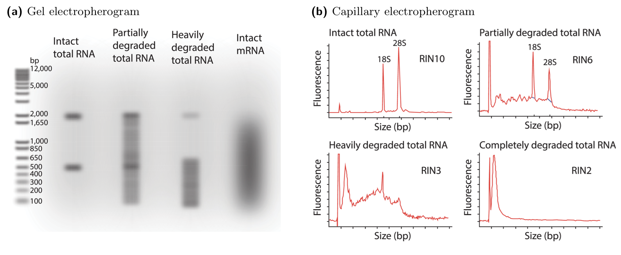
Quality control
RNA quality
RNA Integrity Number
Quality of library prep
Are there PCR duplicates?
Sequencing reads
PHRED scores
Percent mapped
Mapping technique
Quantification technique
Statistical inference method
https://www.agilent.com/en/product/automated-electrophoresis/bioanalyzer-systems/bioanalyzer-rna-kits-reagents/bioanalyzer-rna-analysis-228256

Slide 8
Sequencing platform
Determined by desired read length
Long reads – PacBio
Short reads – Illumina
Many other platforms out there and they are continuing to evolve

Slide 9
Overview of sequencing technology
Overview of platforms
https://www.youtube.com/watch?v=jFCD8Q6qSTM&vl=en
Sequencing by synthesis
https://www.youtube.com/watch?v=fCd6B5HRaZ8

Slide 10
What are the steps we need to consider?
Sequencing platform – Assume Illumina
Library preparation considerations
Number of biological samples
RNA purification method
Targeting of specific transcripts?
Strand specificity of library prep
Paired-end versus single-end sequencing
Sample depth/multiplexing
Read length

Slide 11
Your primary goals of your experiment should guide your experimental design and analysis.
The exact details of how you perform your experiment needs to be guided by your primary goal.
Unless you have all the $$, no single design can capture all of the variability.
Be cognizant of what you can discover using various methods and what you would be missing.
The ENCODE project has data standards for RNA-Seq and Small RNA sequencing that are an excellent resource for many projects.

Slide 12
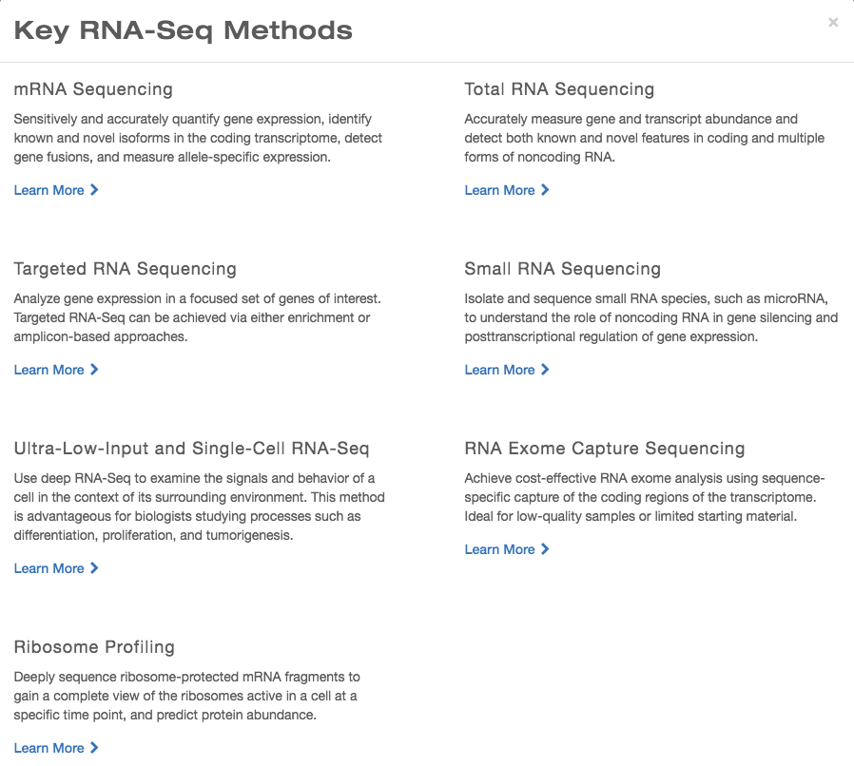
STRANDED vs UNSTRANDED
STRANDED vs UNSTRANDED
https://www.illumina.com/techniques/sequencing/rna-sequencing.html

Slide 13
Recommendations from Illumina September 2019:
Gene expression profiling experiments that are looking for a quick snapshot of highly expressed genes may only need 5–25 million reads per sample. In these cases, consider pooling multiple RNA-Seq samples into one lane of a sequencing run. This allows for high multiplexing of samples.
Experiments looking for a more global view of gene expression, and some information on alternative splicing, typically require 30–60 million reads per sample. This range encompasses most published RNA-Seq experiments for mRNA/whole transcriptome sequencing.
Experiments looking to get an in-depth view of the transcriptome, or to assemble new transcripts, may require 100–200 million reads. In these cases, consider sequencing a few samples across several high output sequencing lanes.
Targeted RNA expression requires fewer reads. For example, Illumina recommends 3 million reads per sample for TruSight RNA Pan Cancer and TruSight RNA Fusion Panel, which are compatible with high plexity pooling of samples.
miRNA-Seq or Small RNA Analysis experiments may require even fewer reads than whole transcriptome sequencing. This requirement varies significantly depending on the tissue type being sequenced. Illumina strongly recommends using the primary literature to determine how many reads are needed, with most applications ranging from 1–5 million reads per sample.
This is based on logic:
Single-end sequencing is best for detecting rare transcripts
Paired-end sequencing is best for studying transcript isoforms

Slide 14
Using RNAseq for differential expression
Differential expression of what?
Differential expression at the level of “genes”, exons, or transcripts
Allele specific expression
Quantification of alternative transcripts

Slide 15
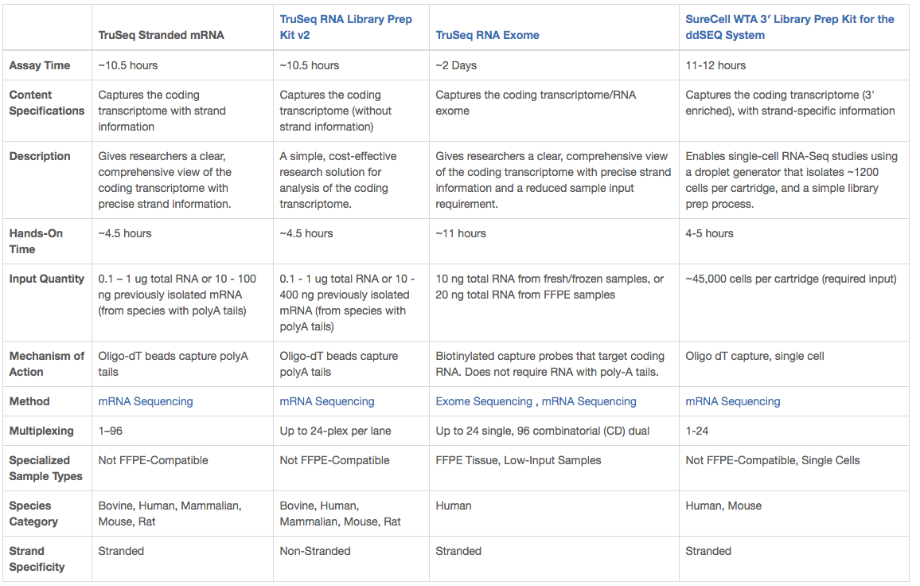
Illumina mRNA sequencing kits, September 2019

Slide 16
Illumina mRNA sequencing kits, September 2019

Slide 17
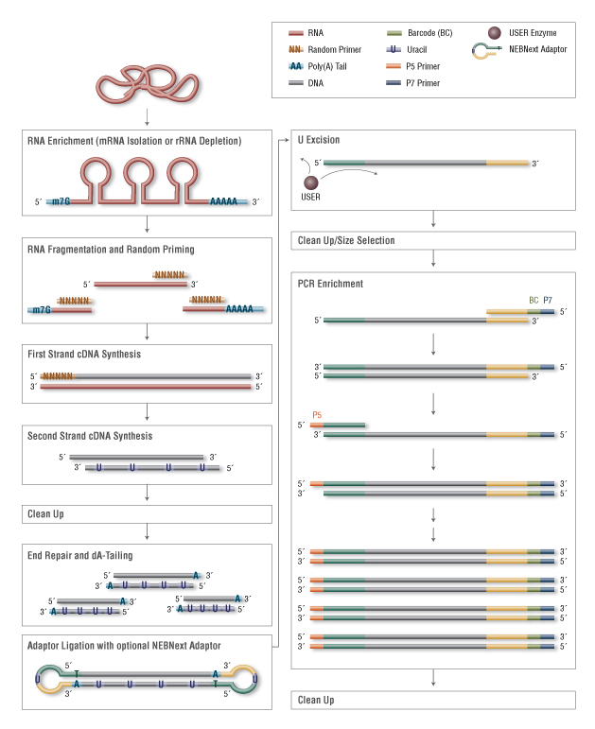
Strand-specific RNAseq Library Prep
Isolate RNA – i.e. oligo dT beads
Fragment it to pieces
Anneal random primers
Elongate to form first strand cDNA
Add UTP and a ”promiscuous” enzyme to synthesize second strand cDNA
Get rid of enzymes, free primers, etc.
Ligate adapters on to double-stranded cDNA
USER enzyme digests strands with UTP
Amplify library using primers that anneal to adapters
Can add barcode sequences to PCR products

Slide 18
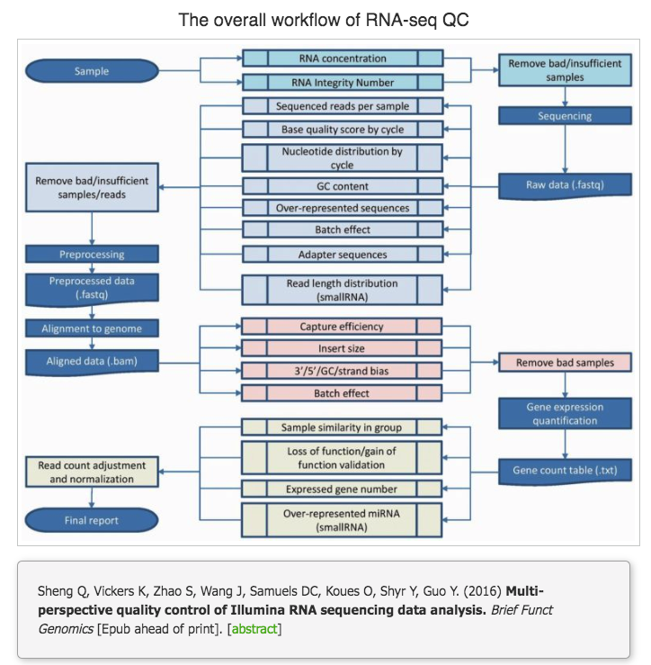
Quality control
RNA quality
RNA Integrity Number
Bioanalyzer Profile
Quality of library prep
Are there PCR duplicates?
Is there rRNA?
Sequencing reads
PHRED scores
Percent mapped

Slide 19
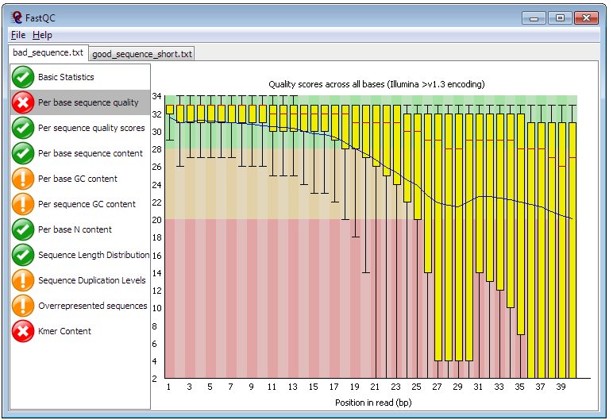
Quality control
RNA quality
RNA Integrity Number
Quality of library prep
Are there PCR duplicates?
Is there rRNA?
Sequencing reads
PHRED scores
Percent mapped
https://www.bioinformatics.babraham.ac.uk/projects/fastqc/

Slide 20

Analysis Decisions
Quality control
RNA quality
RNA Integrity Number
Quality of library prep
Are there PCR duplicates?
Is there rRNA?
Sequencing reads
PHRED scores
Percent mapped

Slide 21
Step 3: Put sequencing reads in context of genome and transcripts.
Align sequencing reads to genome and identify splice junctions using split reads
OR
Use a transcript abundance estimation technique
Breakout link:
https://docs.google.com/document/d/12GrzCfvNU2AmIRtb3RWvza9B6GlPYqlWEE-R3JXHQ9s/edit

Slide 22
How should we map reads?
Do we want to map to a reference genome?
Use a “splice aware” aligner?
Or do we want to map to a transcriptome directly?
What is preferable, to generate a de novo transcriptome or map to known transcripts?

Slide 23
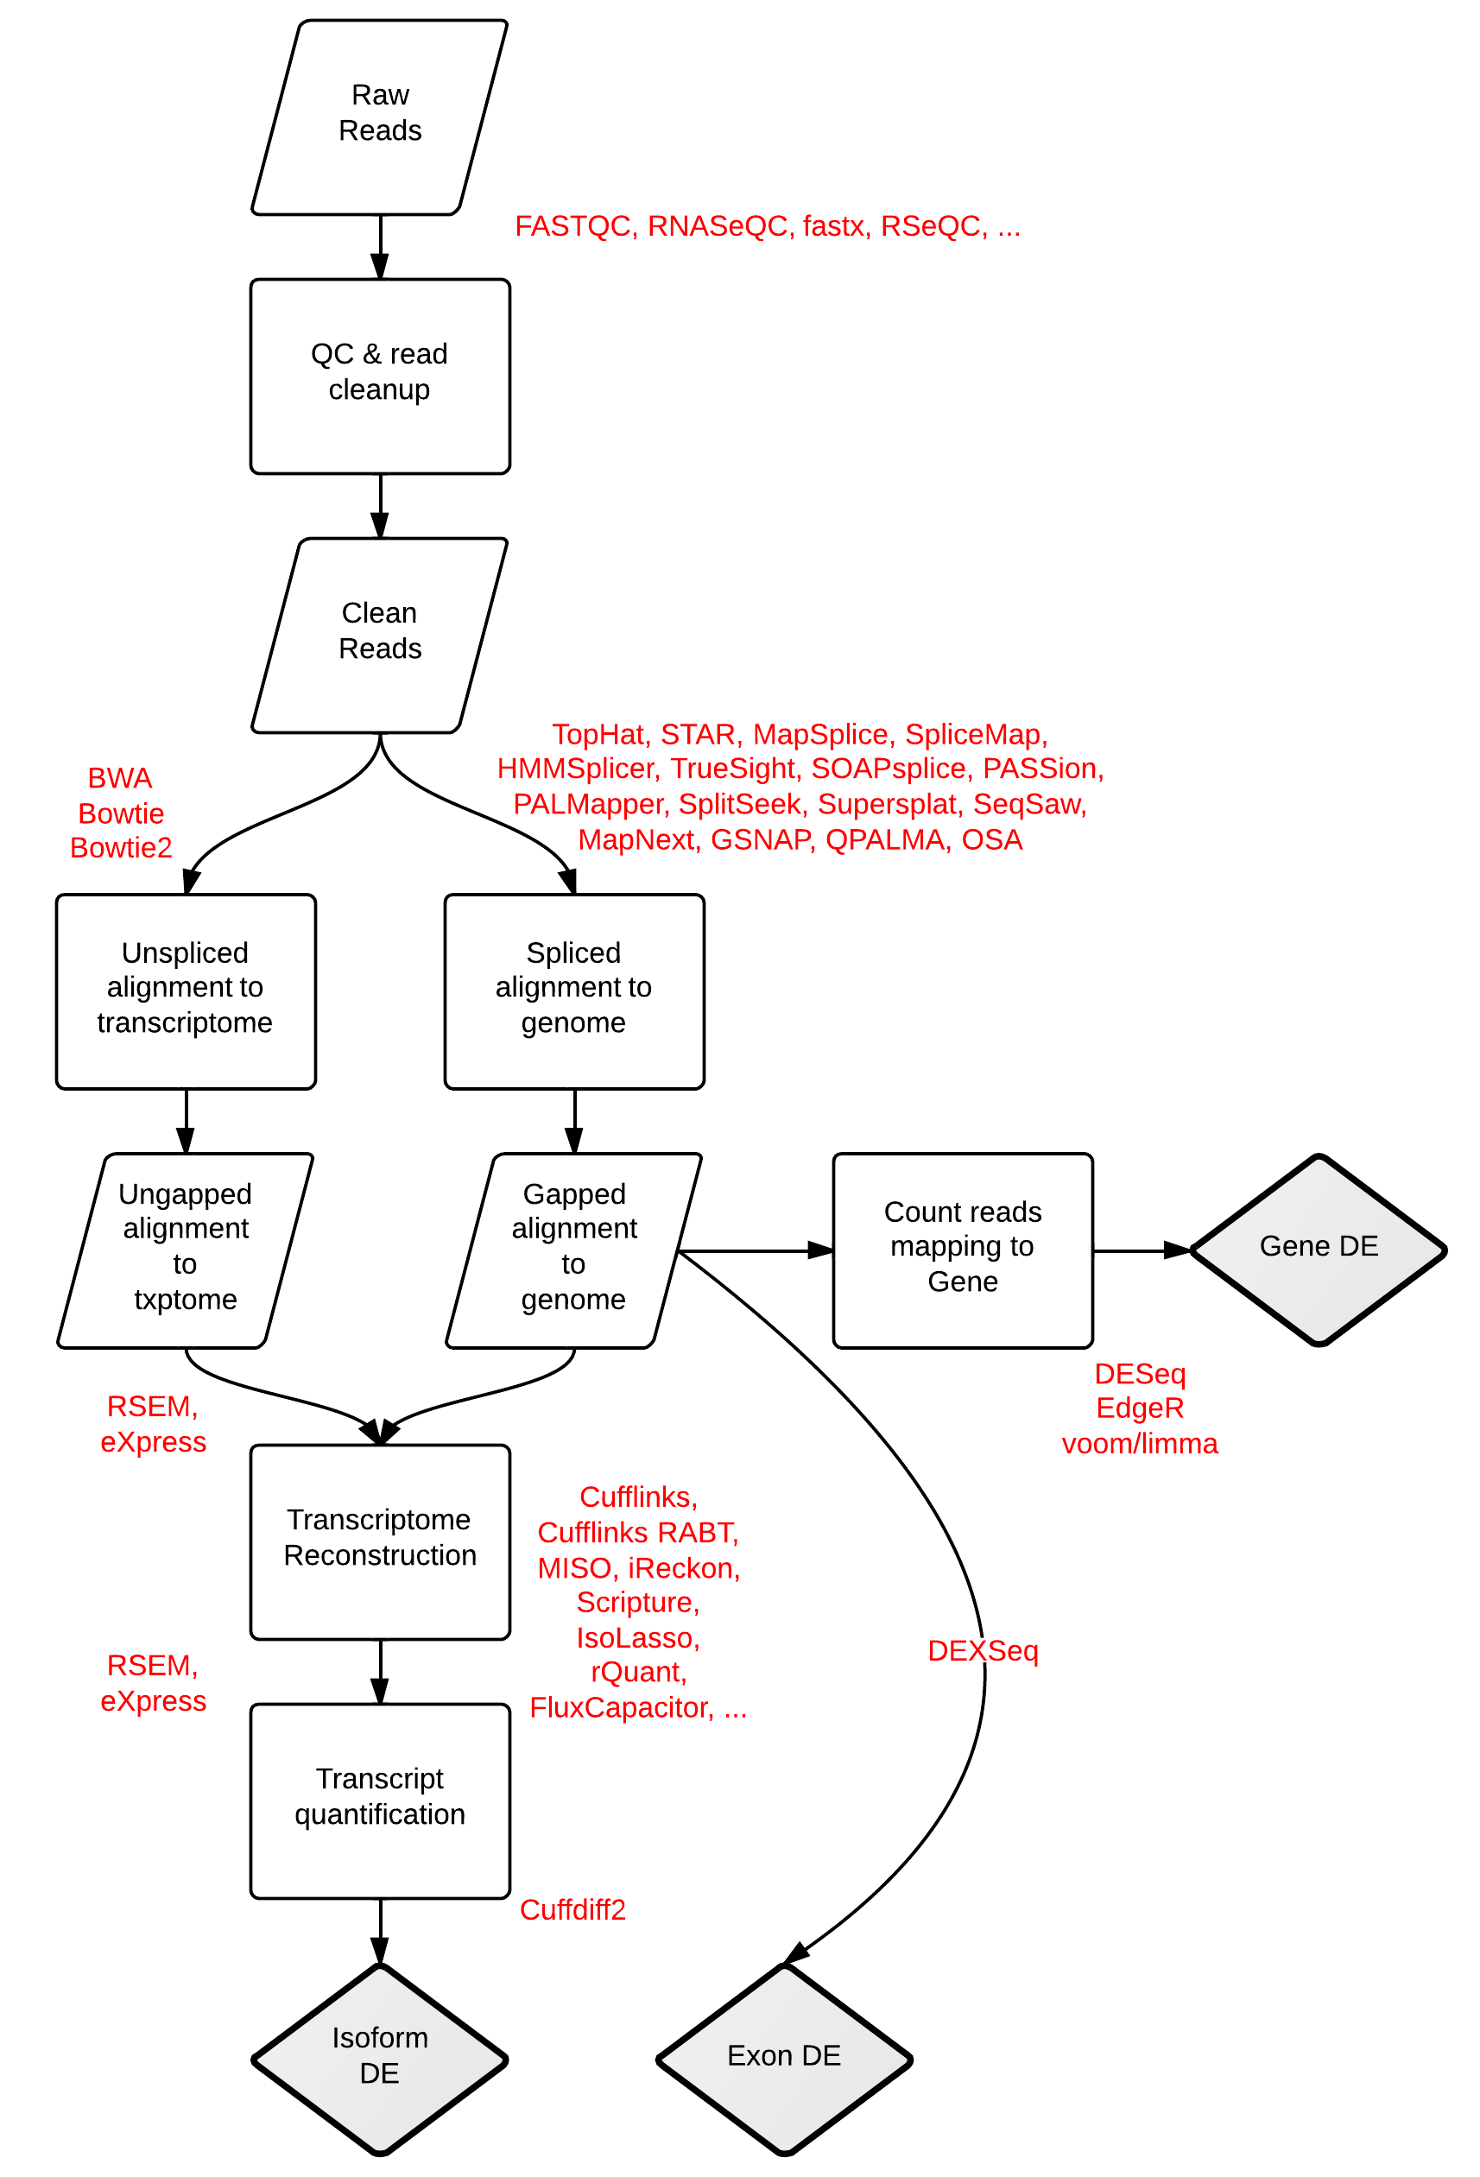
HOW WE MAP THE READS IMPACTS WHAT WE CAN LEARN
RNA-seq Workflows and Tools. Stephen Turner. Figshare. http://dx.doi.org/10.6084/m9.figshare.662782

Slide 24
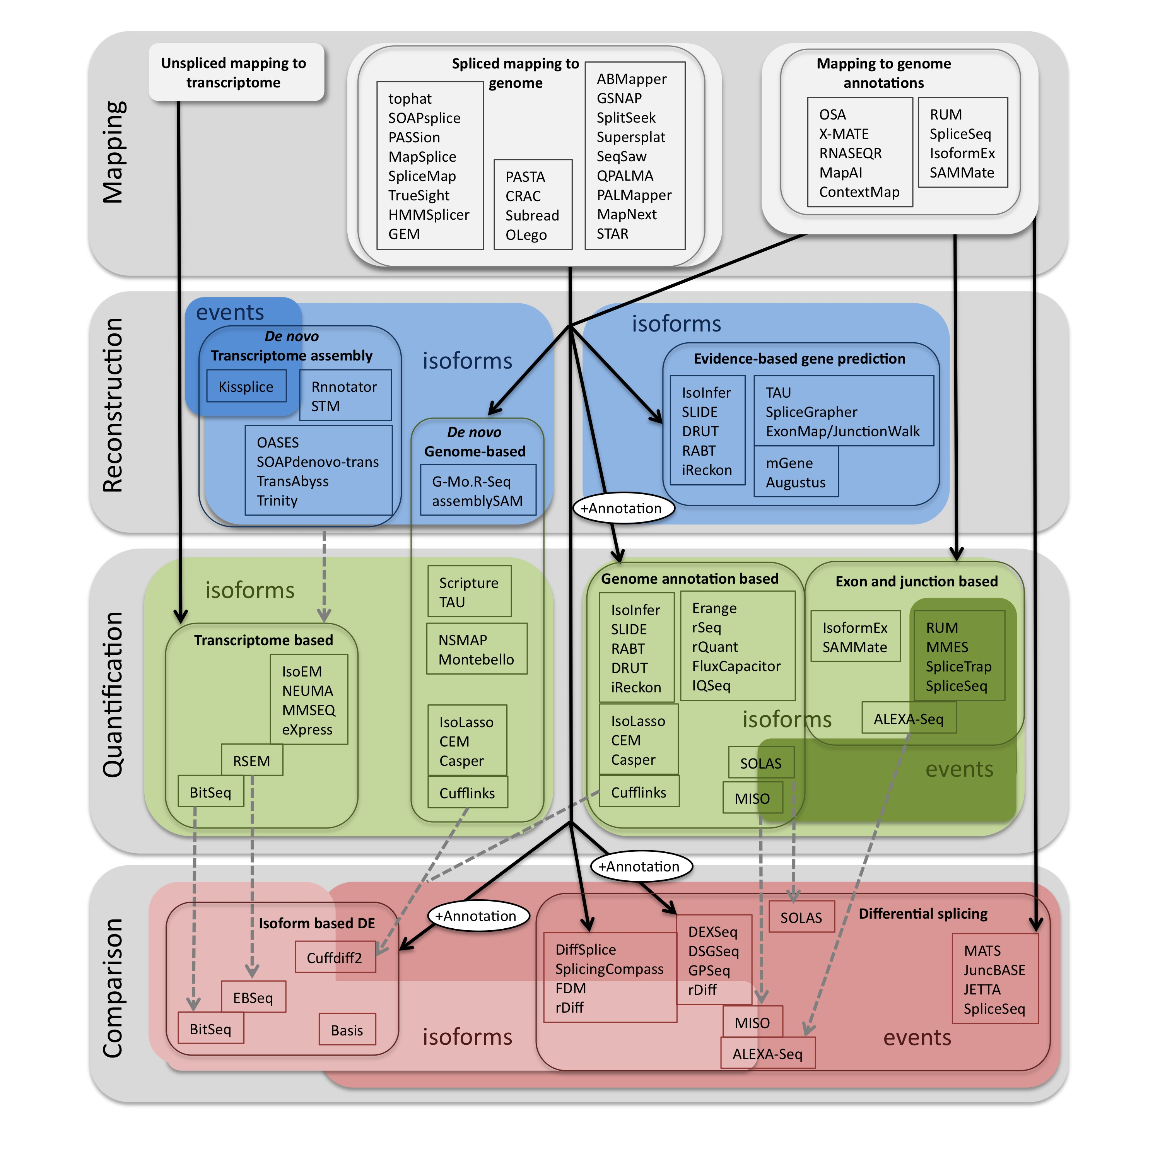
Pipelines for RNA-seq (geared towards splicing)
Methods to Study Splicing from RNA-Seq. Eduardo Eyras, Gael P. Alamancos, Eneritz Agirre. Figshare. http://dx.doi.org/10.6084/m9.figshare.679993 also see http://arxiv.org/abs/1304.5952

Slide 26
Mapping to the genome
How do we deal with alternative transcripts or paralogs during mapping?
"splicing aware" aligners:
Exon First: (tophat, MapSplice, SpliceMap)
Step 1 - map reads to genome
Step 2 -unmapped reads are split, and aligned.
Garber et al., Nat Methods. 2011 Jun;8(6):469-77. doi: 10.1038/nmeth.1613. Epub 2011 May 27.

Slide 27
The variation in the mapping step (at least with a reference genome) seems to have modest effects.
RNA-seq gene profiling - a systematic empirical comparison
Fonseca et al (2014). http://dx.doi.org/10.1101/005207

Slide 28
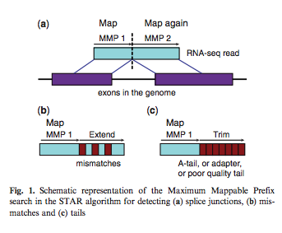
Mapping to a Genome – Which algorithm?
STAR aligner is happy medium – a faster version of seed and extend
Dobin et al. 2012, STAR: ultrafast universal RNA-seq aligner

Slide 29
Mapping to a transcriptome – Which algorithm?
Unspliced read aligners are useful against a transcript (or cDNA) database, such as that generated for a de novo transcriptome.
For this BW is faster than seed based approaches (shrimb & stampy), but the latter may be preferred if mapping to "distant" transcriptomes.

Slide 30
Mapping to transcriptome – Which algorithm?
RSEM, Sailfish, Kalisto, Salmon each have benefits.
Benefit of Salmon is probabilistic abundance uncertainty estimation.
Positional biases in coverage
Fragment-level GC bias
Sequence specific biases at 5’ and 3’
Strand-specific protocols
Fragment length distribution
Dobin et al. 2012, STAR: ultrafast universal RNA-seq aligner

